Slide 1
Software Project Management (MCAE61)
Chapter 6 Activity Planning
Presented By:
Komal S Kallanagoudar
1MS22MC016
Dept MCA
MSRIT

Slide 2
Presentation Outline
Adding the Time Dimension
Th e Forward Pass

Slide 3
Adding the Time Dimension
start thinking about when each activity should be undertaken.
The critical path approach is concerned with two primary objectives:
Planning the project.
Identifying those activities where a delay in their execution.
Forward Pass and Backword Pass

Slide 4
The Forward Pass
The forward pass is carried out to calculate the earliest dates on which each activity may be started and completed.
The forward pass and the calculation of earliest start dates are carried out according to the following reasoning.
Activities A, B and F may start immediately, so the earliest date for their start is zero.
Activity A will take 6 weeks, so the earliest it can finish is week 6 etc…

Slide 5
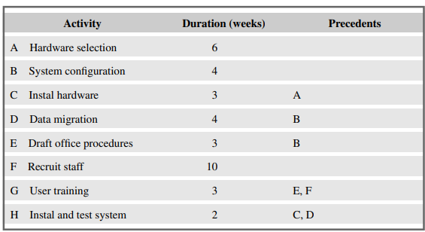
An example project specification with estimated activity durations and precedence requirements

Slide 6
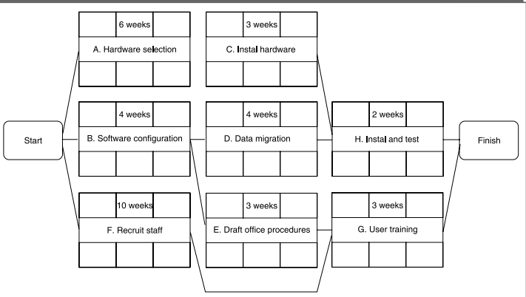
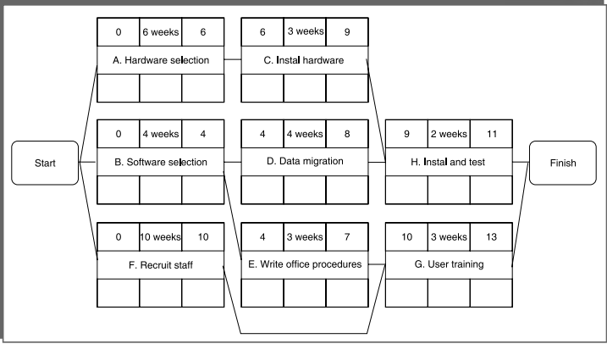
The precedence network for the example project

Slide 7
Thank You

